Slide 1


Slide 2



GITHUB COPILOT BEYOND
THE BASICS
10 WAYS
TO ELEVATE YOUR CODING
THIJS
LIMMEN
YULIYA KHADASEVICH

Slide 3


GITHUB COPILOT

Slide 4







1
GITHUB COPILOT
AI PAIR PROGRAMMER
Visual Studio
Visual Studio Code
Vim/Neovim
Jet Brains

Slide 5

2
GITHUB COPILOT
LICENSES
Individual
Business
Enterprise
$10
per user / month
$19
per user / month
$39
per user / month
* Requires GitHub Enterprise Cloud. ** Currently in preview. (available in 2024)

Slide 6
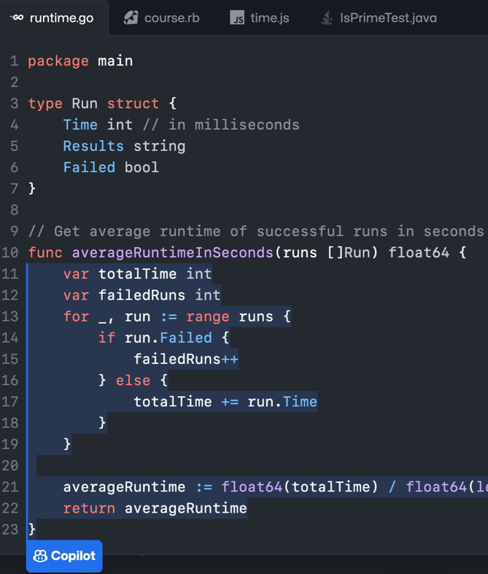



3
GITHUB COPILOT
HOW DOES IT WORK
GitHub-owned Azure tenant
Proxy service
Context
HTTPS
Authenticate
Sanitize (remove PII, secrets)
Sentiment analysis (abusive language, etc.)
Security filter
Sentiment analysis
Optional OSS Duplicate detection
OpenAI LLM
Suggestions

Slide 7

4
GITHUB COPILOT
GPT
Generative Pre-trained Transformer (type of LLM)
Developed by OpenAI
GPT-3.5
GPT-4
GitHub Copilot Completions
Fast
Cheap(er)
GitHub Copilot Chat
10X Powerful
Accurate

Slide 8

LLM
Notes:
GitHub Copilot uses an OpenAI LLM based on GPT-4 behind the scenes.
(As of 2023-12-31 the LLM is Sahara)
---------------------------------------
Speaker
GitHub Copilot is an AI coding assistant that generates code from user input, simplifies repetitive coding tasks, and recommends tests as you code. Its interactive chat feature helps refine code, clarify coding objectives, and tackle programming challenges, improving the development process.
Code starts in the user's IDE (e.g. VS Code, Visual Studio, IntelliJ).
<Click>
The Copilot extension gathers context from open files. That context is used to generate a prompt.
The prompt is sent with SSL encryption to a proxy server living in a GitHub-owned Azure subscription.
At the proxy server, we apply a bunch of filters. For example, we attempt to scrub hate speech, Personal Identifiable Information, etc.
<Click>
The proxy server sends the scrubbed prompt to Large Language Model (LLM).
<Click>
The model produces n suggestions based on the prompt, then deletes the prompt from memory.
<Click>
The suggestions are sent back to the proxy server for another good scrubbing. Again, we filter out hate speech, suggestions with recognized security vulnerabilities, etc.
The proxy server sends the suggestions back to the user's code editor via HTTPS where they are displayed in the user’s IDE.
----------------------------------
SPEAKER NOTES:
Slide is animated
Here’s your code editor with Copilot enabled. (Click)
Your editor provides context to Copilot.
GitHub Copilot uses the OpenAI model
It returns suggestions to your editor where you choose what to accept or ignore.
General info (does not need to be repeated verbatim during training,)
GitHub Copilot provides context from local files. It’s not attached to a repository. The file being edited could be hosted on GitHub or in any other repo, but it’s not a requirement.
GitHub Copilot shares data in an ephemeral way. It’s shared just long enough for GitHub Copilot to provide a suggestion. We do not take that code and put it back into the data model for suggestions.
GitHub Copilot uses a transformative model. Think of something like Google Translate. You put in some words in English, translate it into another language. Google Translate hasn’t seen that exact sentence before necessarily and translated into that new language. Google Translate understands the semantics; the definition of the words, language patterns, whether there is a subject or direct object, and based upon that input, suggests an appropriate result. You could think about GitHub Copilot as a translation tool.
GitHub Copilot will write novel code. But having said that, GitHub Copilot is looking for language patterns and it learns language patterns. There may be times where a particular line, or a few lines of code, appears in thousands and thousands of repositories. That starts to look like a language pattern, rather than its own unique piece of code. In those cases, GitHub Copilot will occasionally regurgitate what it thinks is a pattern as it’s seen it so many times. For that case, the GitHub Copilot team created an IP filter. GitHub Copilot includes a filter which detects code suggestions matching public code on GitHub. You can choose to enable or disable the filter. When the filter is enabled, GitHub Copilot checks code suggestions with their surrounding code of about 150 characters against public code on GitHub. If there is a match or near match, the suggestion will not be shown to you. This is done on the Service side of GitHub Copilot,
Additional talking points if pressed
Why 150 characters? Some of it is a judgement call. You don’t want it so short that you’re comparing a simple if statement, but you want to block anything that would be meaningful. 150 characters on average is about two lines worth of code. It’s a good length to detect if there are a couple of lines of similarity. Based on research, GitHub also found that 150 characters, based on the number of suggestions presented, and accepted, was about the same as it was without the IP being thrown, i.e. the Developer Experience did not deteriorate.
GitHub Copilot is there to enhance your day-to-day work. Accountants don’t do calculations in their head all day. They have calculators and tools to enable them to be more productive. Think of Copilot as the evolution of tooling and Developer Experience for us as developers.

Slide 9
1
WHAT IS AN LLM?
LARGE LANGUAGE MODEL
“A plane flies in the sky”
Tokenized: [1 2 3 4 5 6]
"A car drives"
Tokenized: [1 7 8]
Plane [10, 3, 2]
Based on the tokens and vectors, propose the next word with high probability
Car[10, 3, 1]
0 1 2 3 4 5 6 7
Drive[10, 2, 2]
0 1 2 3
0 1 2 3 4 5 6 7 8 9 10 11
"A car drives … on the road”
Fly [10, 2, 1]
Skateboard [1, 3, 3]
Notes:
BIAS, based on culture. You only find out when starting to use in other cultures
Example of tesla model 3. in the rain it didn’t work properly because it was trained on California roads

Slide 10


10 WAYS

Slide 11
10 WAYS
COPILOT CORE
1

Slide 12
DEMO
1

Slide 13
10 WAYS
IMPROVE CODE
2

Slide 14
2
10 WAYS • IMPROVE CODE
@AGENTS FOR SCOPE
@workspace
Navigate code in workspace by finding relevant files or classes.
@terminal
Assistance with how to run terminal commands
@vscode
Assistance with commands and features in the VS Code editor itself.
Notes:
BIAS, based on culture. You only find out when starting to use in other cultures
Example of tesla model 3. in the rain it didn’t work properly because it was trained on California roads

Slide 15
2
10 WAYS • IMPROVE CODE
/SLASH COMMANDS
/explain
Explain code
/tests
Create unit tests
/fix
Propose a fix for problems in the selected code
/new
Scaffold a new project
/help
Get help on Copilot chat
Notes:
BIAS, based on culture. You only find out when starting to use in other cultures
Example of tesla model 3. in the rain it didn’t work properly because it was trained on California roads

Slide 16
2
10 WAYS • IMPROVE CODE
#HASHTAG COMMANDS
#file
Specific File
#selection
Selected Code
#editor
“Visible“ Source Code
#git
Git context
#terminalSelection
Selected Text in Terminal
#codebase
Search through the open codebase
Notes:
BIAS, based on culture. You only find out when starting to use in other cultures
Example of tesla model 3. in the rain it didn’t work properly because it was trained on California roads

Slide 17
DEMO
2

Slide 18
10 WAYS
PROMPT ENGINEERING
3

Slide 19
3
10 WAYS • PROMPT ENGINEERING
PROMPT ENGINEERING
The process of crafting questions or instructions for AI, aimed at enhancing the quality of its responses

Slide 20
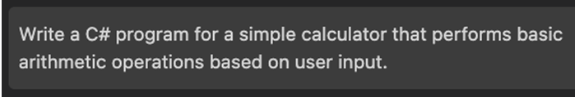
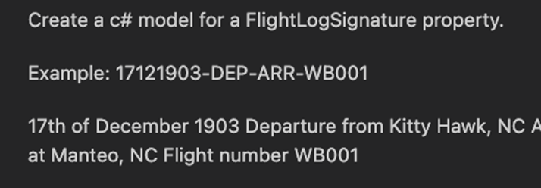
3
10 WAYS • PROMPT ENGINEERING
BASIC TECHNIQUES
Zero-shot prompting
One-shot and
Few-shot prompting
Notes:
Advanced techniques in prompt engineering are designed to optimize interactions with AI models, pushing the boundaries of how effectively these models can understand and respond to human input. These techniques are especially relevant in domains where nuanced or contextually rich output is required

Slide 21
DEMO
3

Slide 22


TESTING

Slide 23
10 WAYS
UNIT TESTING
4

Slide 24
4
10 WAYS
UNIT TESTING
Unit Tests
Integration Tests
Acceptance Tests
More Isolation
More Integration
GitHub Copilot's design
excels at handling smaller code segments
to maintain full context
Notes:
Challenges in Writing Unit Tests
Address common challenges developers face: time-consuming to write, requires thorough understanding of the codebase, and can be repetitive or complex.
How GitHub Copilot Enhances Unit Testing
Explain how GitHub Copilot can assist in generating unit tests: "By suggesting test cases based on your code and comments, Copilot can significantly reduce the time and effort required to create thorough tests."
Highlight the AI's ability to suggest tests for edge cases and scenarios you might not immediately consider.

Slide 25
DEMO
4

Slide 26
10 WAYS
ACCEPTANCE TESTING
5

Slide 27
5
10 WAYS
ACCEPTANCE TESTING
Unit Tests
Integration Tests
Acceptance Tests
More Isolation
More Integration
Notes:
BIAS, based on culture. You only find out when starting to use in other cultures
Example of tesla model 3. in the rain it didn’t work properly because it was trained on California roads

Slide 28

5
10 WAYS • ACCEPTANCE TESTING
BDD
Behaviour Driven Development Testing Tool for .NET applications
Gherkin Language
Given, When, Then

Slide 29
DEMO
5

Slide 30
10 WAYS
TROUBLESHOOTING
6

Slide 31
6
10 WAYS
TROUBLESHOOTING
GitHub Copilot is useful for debugging and troubleshooting:
Exception explanation
Code analysis
Suggesting fixes
Code refactoring
Code documentation
Helps with automated testing
Notes:
Exception Explanation
•Understanding Exceptions: Copilot can provide explanations and insights into what specific exceptions mean. By simply pasting the exception message into your code editor with Copilot enabled, it can generate comments explaining the potential causes of the exception.
Code Analysis
•Identifying Common Pitfalls: Copilot can analyze the context of your code to identify common pitfalls that might lead to exceptions. For instance, if your code is prone to a NullPointerException in Java or a TypeError in Python, Copilot can suggest null checks or type checks respectively.
Suggesting Fixes
•Generating Fix Suggestions: Upon identifying the potential cause of an exception, Copilot can suggest specific lines of code or code modifications to resolve the issue. This might include adding exception handling constructs like try-catch blocks, or it might suggest more idiomatic ways to achieve your goal without running into exceptions.
Code Refactoring
•Improving Code Quality: Copilot can suggest refactoring opportunities to make your code more robust and less prone to exceptions. This could involve recommending more reliable libraries, utilizing language-specific features, or restructuring your code to avoid anti-patterns.
Documentation and Examples
•Providing Contextual Examples: Copilot can generate code snippets that demonstrate the correct usage of APIs or language features, including how to handle exceptions properly. This is especially helpful when working with unfamiliar libraries or frameworks.
Automated Testing
•Generating Test Cases: Copilot can help you write unit tests that cover edge cases you might not have considered, potentially catching exceptions before they become a problem in a production environment. By writing tests that mimic various scenarios, you can identify and resolve exceptions early in the development cycle.

Slide 32
DEMO
6

Slide 33


VISUALIZATION
Notes:
GitHub Copilot uses an OpenAI LLM based on GPT-4 behind the scenes.
(As of 2023-12-31 the LLM is Sahara)
---------------------------------------
Speaker
GitHub Copilot is an AI coding assistant that generates code from user input, simplifies repetitive coding tasks, and recommends tests as you code. Its interactive chat feature helps refine code, clarify coding objectives, and tackle programming challenges, improving the development process.
Code starts in the user's IDE (e.g. VS Code, Visual Studio, IntelliJ).
<Click>
The Copilot extension gathers context from open files. That context is used to generate a prompt.
The prompt is sent with SSL encryption to a proxy server living in a GitHub-owned Azure subscription.
At the proxy server, we apply a bunch of filters. For example, we attempt to scrub hate speech, Personal Identifiable Information, etc.
<Click>
The proxy server sends the scrubbed prompt to Large Language Model (LLM).
<Click>
The model produces n suggestions based on the prompt, then deletes the prompt from memory.
<Click>
The suggestions are sent back to the proxy server for another good scrubbing. Again, we filter out hate speech, suggestions with recognized security vulnerabilities, etc.
The proxy server sends the suggestions back to the user's code editor via HTTPS where they are displayed in the user’s IDE.
----------------------------------
SPEAKER NOTES:
Slide is animated
Here’s your code editor with Copilot enabled. (Click)
Your editor provides context to Copilot.
GitHub Copilot uses the OpenAI model
It returns suggestions to your editor where you choose what to accept or ignore.
General info (does not need to be repeated verbatim during training,)
GitHub Copilot provides context from local files. It’s not attached to a repository. The file being edited could be hosted on GitHub or in any other repo, but it’s not a requirement.
GitHub Copilot shares data in an ephemeral way. It’s shared just long enough for GitHub Copilot to provide a suggestion. We do not take that code and put it back into the data model for suggestions.
GitHub Copilot uses a transformative model. Think of something like Google Translate. You put in some words in English, translate it into another language. Google Translate hasn’t seen that exact sentence before necessarily and translated into that new language. Google Translate understands the semantics; the definition of the words, language patterns, whether there is a subject or direct object, and based upon that input, suggests an appropriate result. You could think about GitHub Copilot as a translation tool.
GitHub Copilot will write novel code. But having said that, GitHub Copilot is looking for language patterns and it learns language patterns. There may be times where a particular line, or a few lines of code, appears in thousands and thousands of repositories. That starts to look like a language pattern, rather than its own unique piece of code. In those cases, GitHub Copilot will occasionally regurgitate what it thinks is a pattern as it’s seen it so many times. For that case, the GitHub Copilot team created an IP filter. GitHub Copilot includes a filter which detects code suggestions matching public code on GitHub. You can choose to enable or disable the filter. When the filter is enabled, GitHub Copilot checks code suggestions with their surrounding code of about 150 characters against public code on GitHub. If there is a match or near match, the suggestion will not be shown to you. This is done on the Service side of GitHub Copilot,
Additional talking points if pressed
Why 150 characters? Some of it is a judgement call. You don’t want it so short that you’re comparing a simple if statement, but you want to block anything that would be meaningful. 150 characters on average is about two lines worth of code. It’s a good length to detect if there are a couple of lines of similarity. Based on research, GitHub also found that 150 characters, based on the number of suggestions presented, and accepted, was about the same as it was without the IP being thrown, i.e. the Developer Experience did not deteriorate.
GitHub Copilot is there to enhance your day-to-day work. Accountants don’t do calculations in their head all day. They have calculators and tools to enable them to be more productive. Think of Copilot as the evolution of tooling and Developer Experience for us as developers.

Slide 34
10 WAYS
LOADING …
7

Slide 35
7
10 WAYS
LOADING …
-WHAT TO PUT HERE?
Notes:
BIAS, based on culture. You only find out when starting to use in other cultures
Example of tesla model 3. in the rain it didn’t work properly because it was trained on California roads

Slide 36
DEMO
7

Slide 37
10 WAYS
UI / UX
8

Slide 38
8
10 WAYS
UI / UX
-WHAT TO PUT HERE?
Notes:
BIAS, based on culture. You only find out when starting to use in other cultures
Example of tesla model 3. in the rain it didn’t work properly because it was trained on California roads

Slide 39
DEMO
8

Slide 40
10 WAYS
UI TESTS
9

Slide 41
9
10 WAYS
UI TESTS
-WHAT TO PUT HERE?
Notes:
BIAS, based on culture. You only find out when starting to use in other cultures
Example of tesla model 3. in the rain it didn’t work properly because it was trained on California roads

Slide 42
DEMO
9

Slide 43


ADVANCED

Slide 44
10 WAYS
CHAIN OF THOUGHT
10

Slide 45
10
10 WAYS
CHAIN OF THOUGHT
Enables Complex Reasoning capabilities through Intermediate Reasoning steps to get Better Results on complex tasks
Notes:
Advanced techniques in prompt engineering are designed to optimize interactions with AI models, pushing the boundaries of how effectively these models can understand and respond to human input. These techniques are especially relevant in domains where nuanced or contextually rich output is required

Slide 46
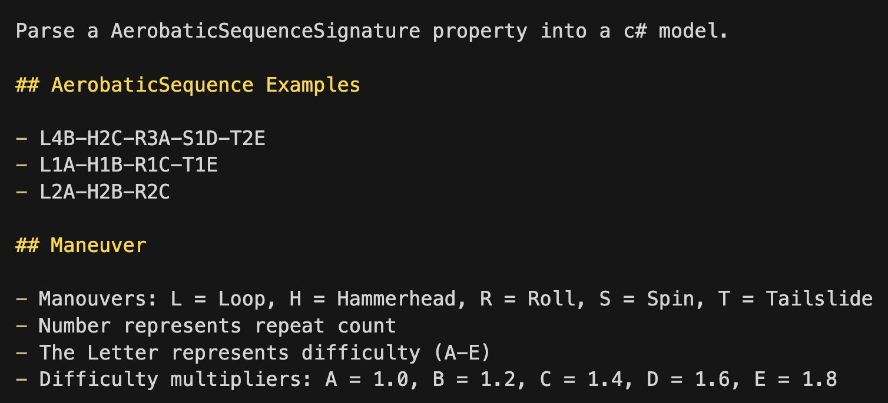
10
10 WAYS • CHAIN OF THOUGHT
AEROBATICS SEQUENCE SIGNATURE (FICTIONAL)
Notes:
Advanced techniques in prompt engineering are designed to optimize interactions with AI models, pushing the boundaries of how effectively these models can understand and respond to human input. These techniques are especially relevant in domains where nuanced or contextually rich output is required

Slide 47
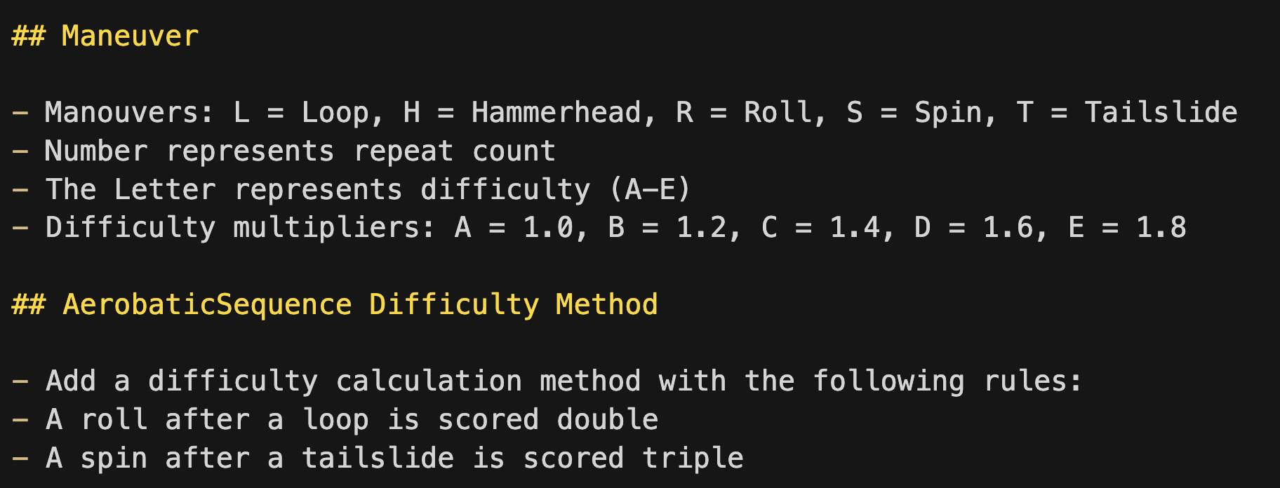
10
10 WAYS • CHAIN OF THOUGHT
CALCULATE DIFFICULTY
Notes:
Advanced techniques in prompt engineering are designed to optimize interactions with AI models, pushing the boundaries of how effectively these models can understand and respond to human input. These techniques are especially relevant in domains where nuanced or contextually rich output is required

Slide 48
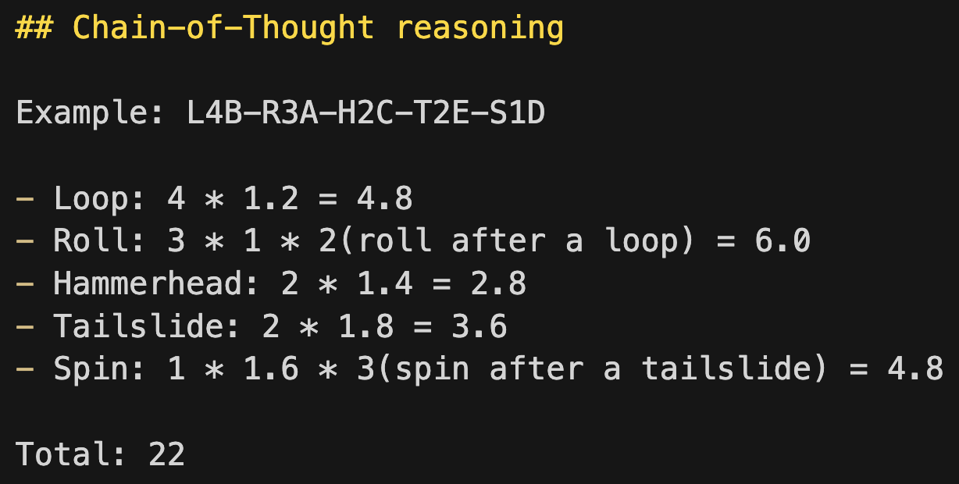
10
10 WAYS • CHAIN OF THOUGHT
CHAIN OF THOUGHT REASONING
Notes:
Advanced techniques in prompt engineering are designed to optimize interactions with AI models, pushing the boundaries of how effectively these models can understand and respond to human input. These techniques are especially relevant in domains where nuanced or contextually rich output is required

Slide 49
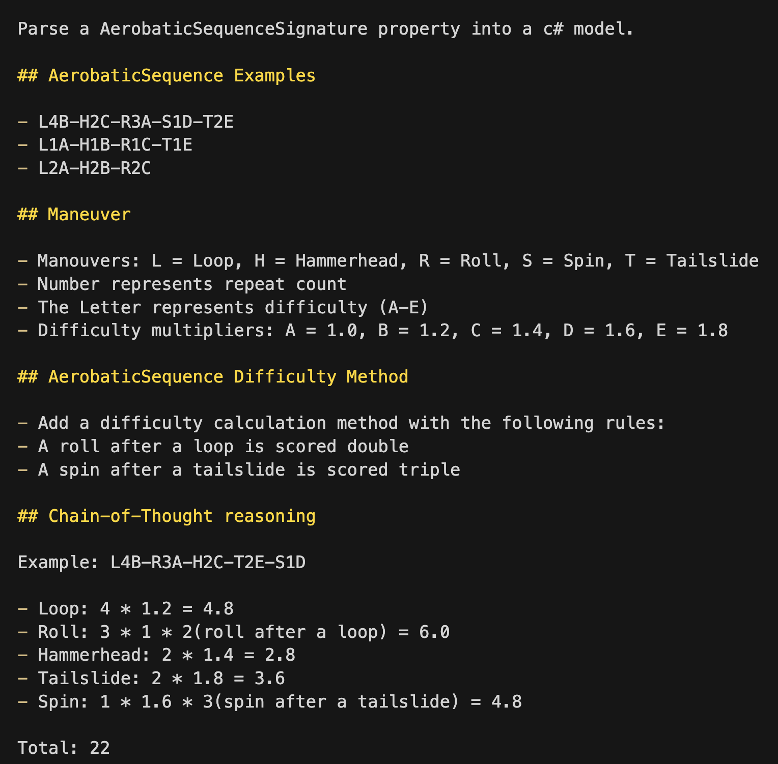
Notes:
This is the final instruction for Chain-of-Thought to make Copilot go through the process step by step, like a human would do.

Slide 50
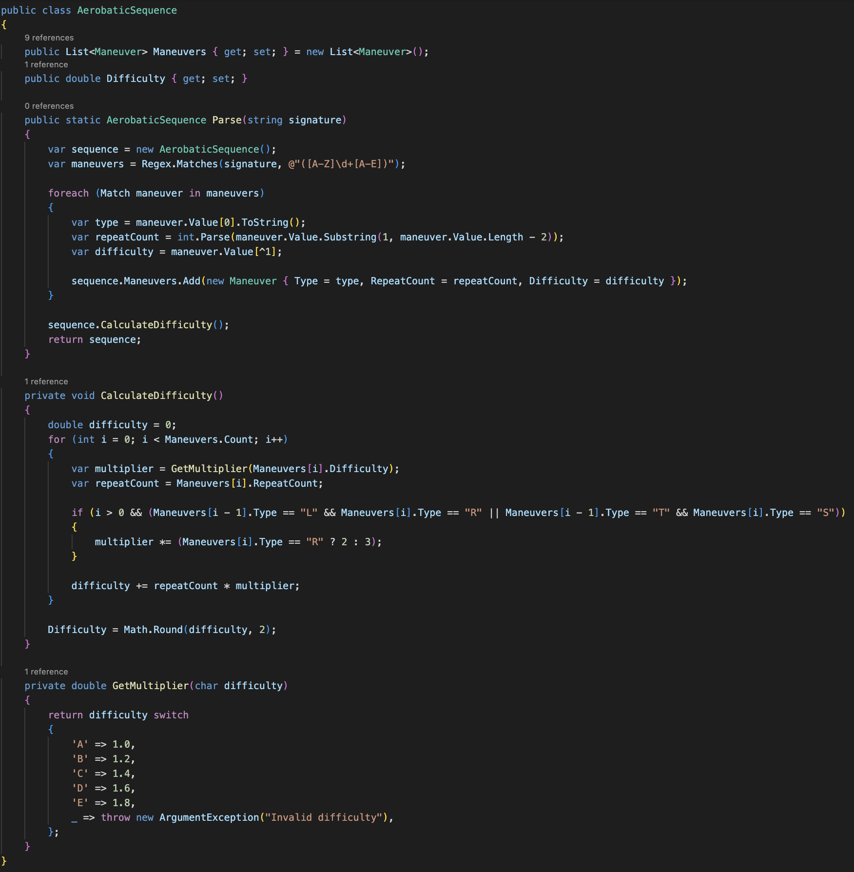
Notes:
This is the final instruction for Chain-of-Thought to make Copilot go through the process step by step, like a human would do.

Slide 51
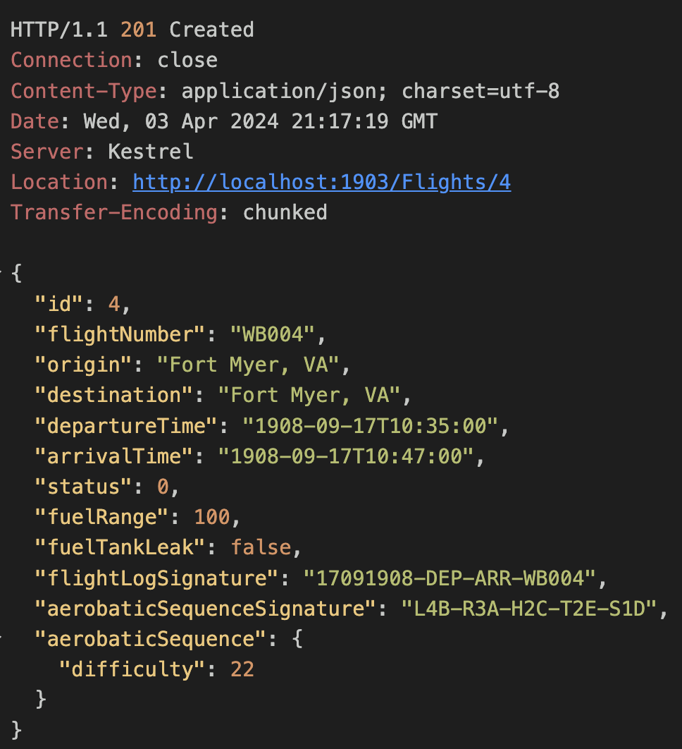
Notes:
This is the final instruction for Chain-of-Thought to make Copilot go through the process step by step, like a human would do.

Slide 52

FINAL
THOUGHT

Slide 53
X
FINAL THOUGHTS
FINAL THOUGHTS
Do’s
Set clear goals
Provide detailed instructions
Refine through feedback
Use for creativity and exploration
Make flight hours by using the tool
Don’ts
Rely blindly; verify
Expect instant perfection

Slide 54


X
FINAL THOUGHTS
USEFUL LINKS
GitHubNext:
https://githubnext.com
More prompt engineering techniques:
https://www.promptingguide.ai

